Slide 1
Secure Data Hiding In Images Using Steganography
CAPSTONE PROJECT
Presented By: Heet Vadgama
Student Name: Heet Vadgama
College Name: Sardar Vallabhbhai Patel Institute Of Technology,Vasad
Department : Computer Engineering

Slide 2
OUTLINE
Problem Statement
Technology used
Wow factor
End users
Result
Conclusion
Git-hub Link
Future scope

Slide 3
Problem Statement
Traditional encryption methods are easily detectable and can raise suspicion.
Need for a secure way to hide confidential messages within images.
Ensuring data security while maintaining the integrity of the cover image.
Making encryption and decryption accessible to non-technical users through a simple interface.

Slide 4
Technology used
Programming Language: Python
Image Processing Library: Pillow (formerly known as PIL – Python Imaging Library)
Steganography: Hiding data in images using LSB (Least Significant Bit) technique.
File Handling & Security: Bitwise Operations: Embedding message bits into image pixel values.
Additional Libraries: NumPy is a powerful library used for numerical computations in Python
Platform: Windows 11,IDLE

Slide 5
Wow factors
Secret Communication Without Suspicion: The use of steganography allows confidential messages to be hidden within an image without any visible alterations.
Natural-Looking Cover: The message is hidden in such a way that the cover image remains visually identical, maintaining the integrity and appearance of the original image, which is crucial for avoiding detection.
Least Significant Bit (LSB) Method: Minimal Impact on Image Quality - The LSB method modifies only the least significant bits of pixel values, resulting in negligible or imperceptible changes to the image.
Efficient Data Hiding: By altering the least significant bits, the method allows for efficient encoding of data with minimal impact on the file size or image properties.
Smart Message Encoding: The use of a delimiter (1111111111111110) at the end of the binary message ensures that the decoding process knows when to stop reading.
Flexibility in Cover Media: Though the example here uses images, the concept can be extended to other media like audio or video files, broadening the scope of the application.

Slide 6
End users
Journalists and Whistleblowers
Political Activists and Dissidents
Government Agencies and Intelligence Services
Corporations and Cybersecurity Firms
Data Security Professionals
Military Personnel
Law Enforcement
Cryptocurrency and Blockchain Enthusiasts

Slide 7
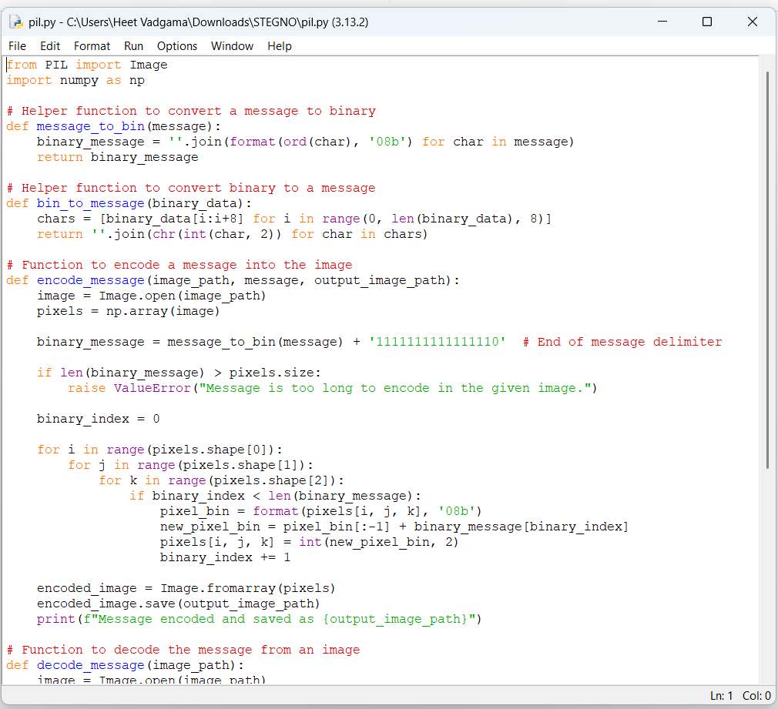
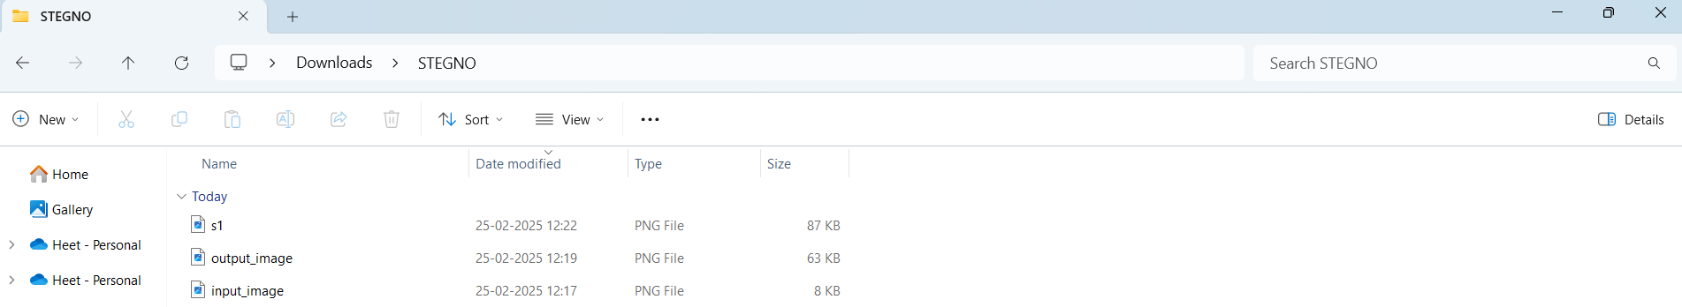
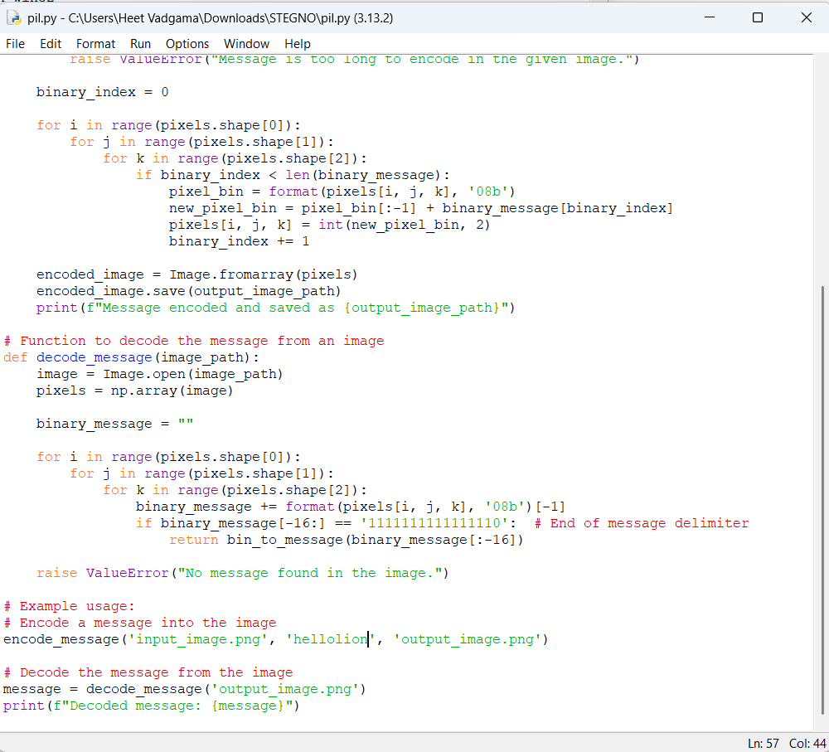
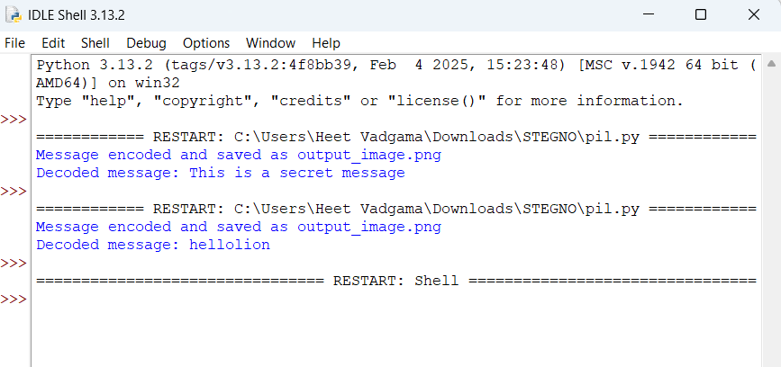


Results
Encryption Code:
Image generation :
Decryption Code:
Run Shell :
Input Image File:
Output Image File:

Slide 8
Conclusion
In conclusion, steganography offers a powerful, covert method of communication by embedding confidential information within ordinary media like images, audio, and video, making it difficult to detect. As privacy concerns, data security threats, and the demand for covert communication grow, steganography provides a unique solution that can be used across various domains such as journalism, cybersecurity, intelligence, digital forensics, and even in day-to-day secure communication.
As this technology continues to grow, it will be essential to establish ethical guidelines and regulations to prevent misuse while ensuring that steganography remains a valuable tool for privacy-conscious individuals, organizations, and governments.

Slide 9
GitHub Link
https://github.com/HeetVadgama/STEGNO

Slide 10
Future scope
3D Models and Augmented Reality (AR): As 3D models, augmented reality (AR), and virtual reality (VR) Support for Audio & Video Steganography – Expanding beyond images.
Steganography in Blockchain: Blockchain technology is inherently transparent, but with the rising need for privacy
Secure IoT Communication: With the increasing use of Internet of Things (IoT) devices
Secure Cloud Communication: As cloud computing continues to expand, steganography could be applied to secure communication between cloud services and users
Multi-Layer Security – Combining steganography with blockchain for ultra-secure communication.

Slide 11
THANK YOU

